Slide 1
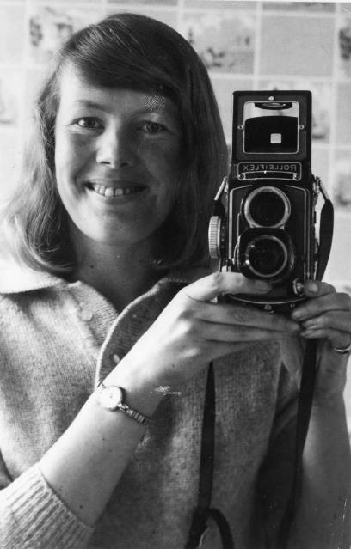


Susan MacFarlane Press Photographer in the 1960s
Working for the Oxford Mail she had to cover stories relating to:
Local events
Celebrity stories
Theatre reviews
Sporting events
www.passingtheflame.uk

Slide 2
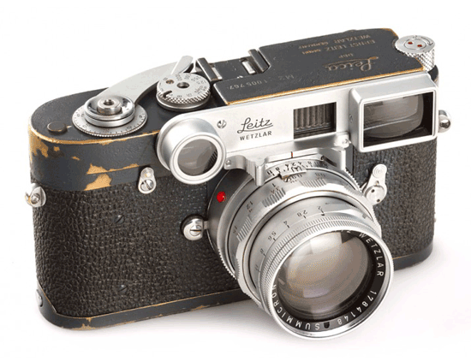
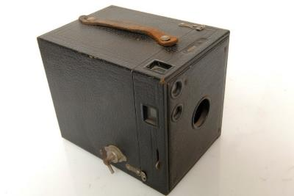
First Inspiration!
“My eight years at Oxford High School did nothing for my confidence and I left not knowing what I wanted to do. A wealthy family friend who was a chocolate maker, had all the latest Leica camera equipment, he gave me a simple £1 box Brownie, but I still got good results and loved taking pictures of people. When he saw them he said: 'Ah, you ARE a photographer!' “
www.passingtheflame.uk

Slide 3
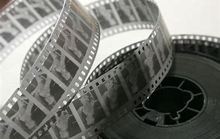
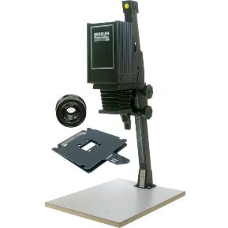
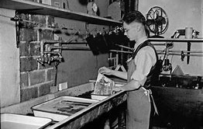
Making Photographs in the 1960s
Chemical s were then used to develop the images into pictures on special paper
Called negatives as they reversed colours to allow light through an ‘enlarger’
www.passingtheflame.uk

Slide 4
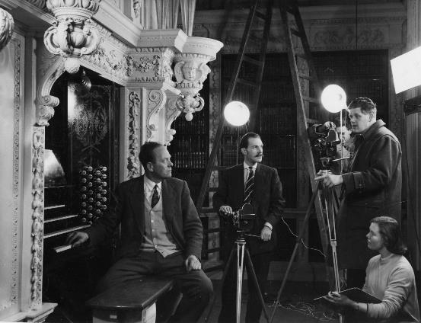
First job working in a photographic shop as a sales girl.
Then moved on to becoming a script continuity and stills girl for Oxford Film Productions.
They made films to promote Blenheim Palace, marmalade and films of Olympic hopefuls!
Oxford Film Productions
www.passingtheflame.uk

Slide 5
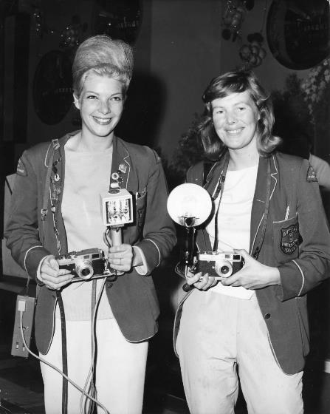
Dark room assistant at the Oxford Mail
Camera Girl Butlins in Bognor’s holiday camp for 6000 holiday makers and 1500 staff. Sold snaps of swimming, fancy dress and talent competitions.
She worked with 6 men who only took black and white pictures customers could chose from. But her colour pictures needed longer processing. And they only saw them after payment in the post .
However, she still made more money than them. Enough to buy her first car and build her confidence to become a press photographer.
Colour Camera Girl
www.passingtheflame.uk

Slide 6
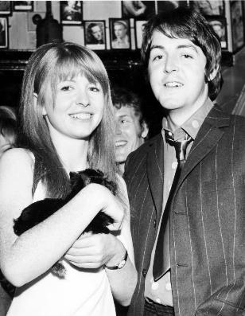
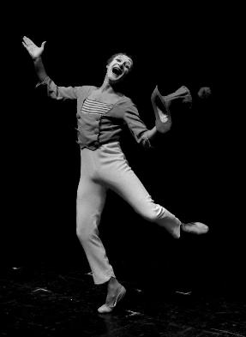
Paul McCartney from the Beatles and actress Jane Asher
Marcel Marceau –famous French actor and mime artist
The Queen and Royal family
Politicians, religious figures and activists like Nelson Mandela
Press Photographer
taking pictures of celebrities and V.I.P.s
www.passingtheflame.uk

Slide 7
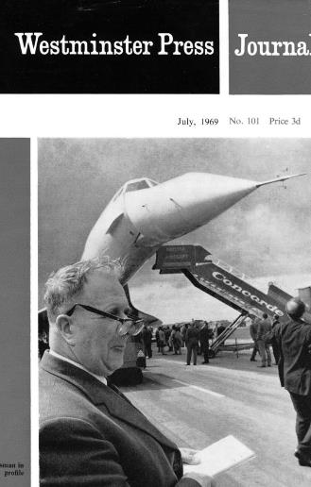
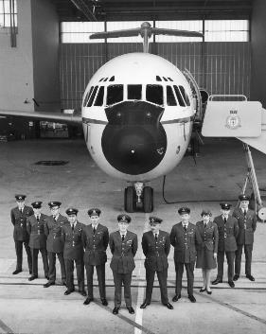
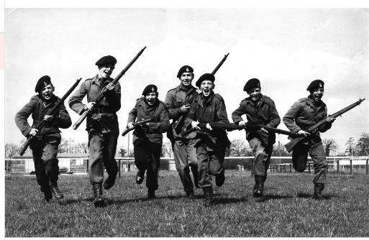
Still a big focus on the war and aviation
Young boys training as army cadets
Concorde – (flew faster than speed of sound)
Travelled around the world with the RAF
www.passingtheflame.uk

Slide 8
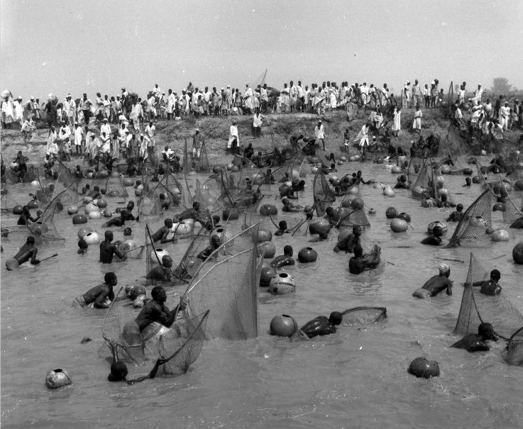
Other Countries:
Argungu fishing festival in West Africa. 1000 men along banks of the Sahara.
Allowed to fish 1 day of the year. A horn at 11am signalled them to start.
Charging like an army in full battle encouraged on by chanters and drummers.
www.passingtheflame.uk

Slide 9
“My pictures of the fishing festival earned a back-page spread in The Times newspaper for £25.
But I nearly missed my plane home. The gates were closed and the engines had started. Clambering over the perimeter fence, running up the tarmac I ran up to the cockpit with a long spear I was taking home for my father.
The pilot ordered the steps back out and jokingly said: 'I had to let you on, I thought you were going to puncture the fuselage.' Very naughty but I panicked as my flight only went once a week!”
www.passingtheflame.uk

Slide 10
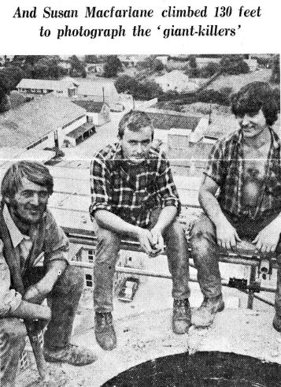
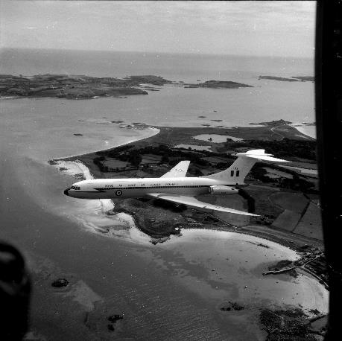
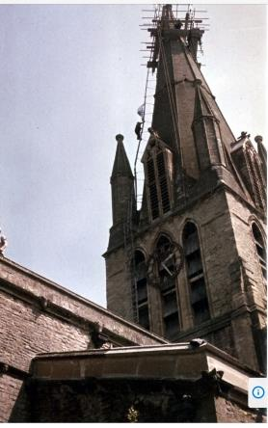
Pictures from Height
Men working up Mill Chimneys, Restoration of Witney Steeple no ropes and a VC10 jet liner – (harnessed out of another plane)
www.passingtheflame.uk

Slide 11
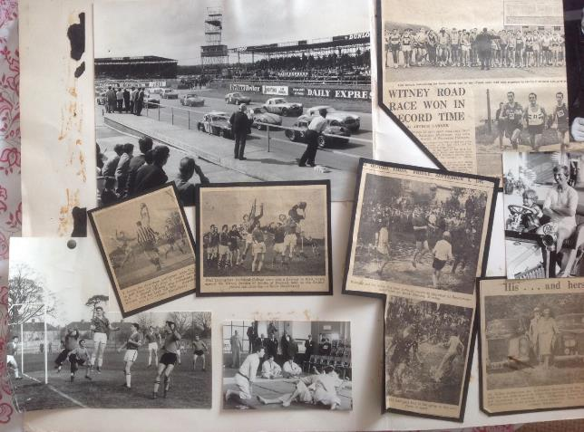
Press Photography of local Sports events
Copy right of the newspapers.
One shot to get a good picture.
Couldn’t check them like digital pictures.
www.passingtheflame.uk

Slide 12
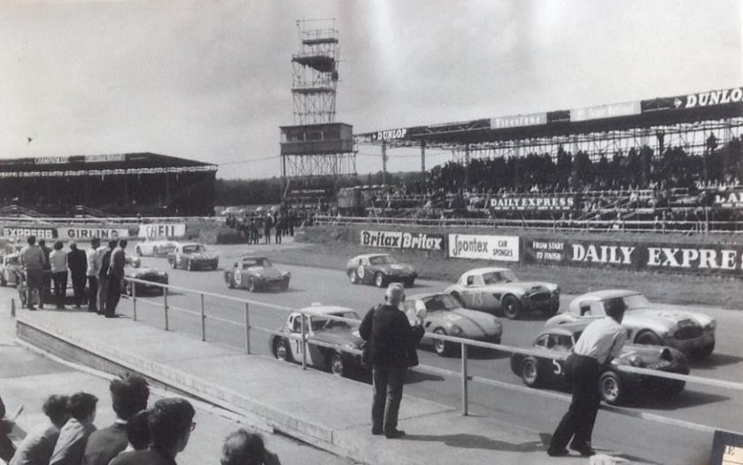
Rally Driving
www.passingtheflame.uk

Slide 13
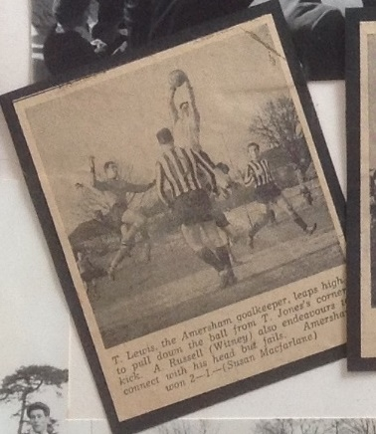
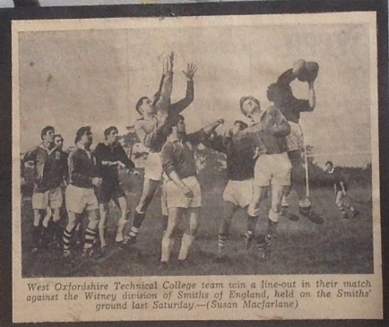
Rugby
www.passingtheflame.uk

Slide 14
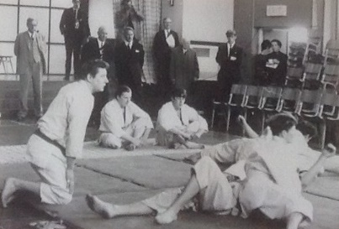
Judo
www.passingtheflame.uk

Slide 15
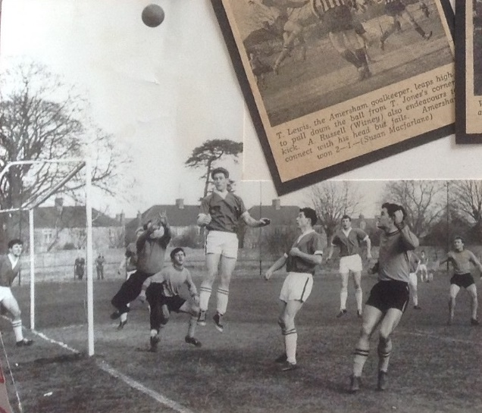
Football
www.passingtheflame.uk

Slide 16
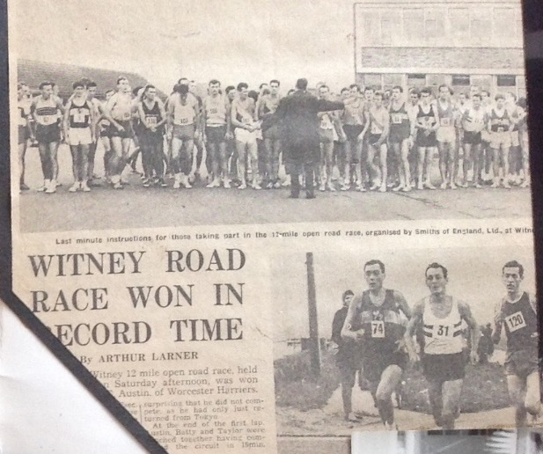
Road Racing
www.passingtheflame.uk

Slide 17
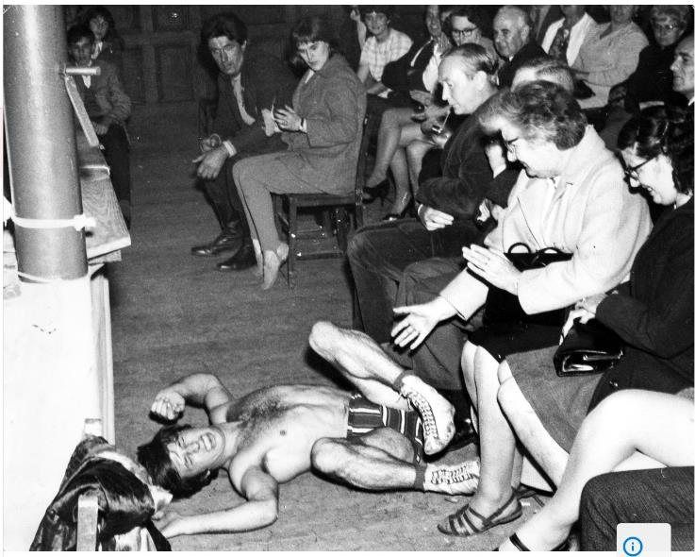
Wrestling
www.passingtheflame.uk

Slide 18
What makes a good action shot in sport?
In groups discuss…..
What has changed in the way we take journalistic pictures today?
www.passingtheflame.uk

